Slide 1
Secure patients-doctor records
Presented by:
M. Ananthi
811324149001
B.E CSE(Cyber security)

Slide 2

Proposed solutions :
Secure Doctor is a web-based application designed to manage doctor and patient information securely.
It enables doctors to manage consultations and maintain patient medical records.
It uses secure authentication and role-based access to protect sensitive information.
The system stores and retrieves records through a MySQL database.
The application is deployed online to support access through a web browser.
Secure Doctor is a web-based application designed to manage doctor and patient information securely.
It enables doctors to manage consultations and maintain patient medical records.
It uses secure authentication and role-based access to protect sensitive information.
The system stores and retrieves records through a MySQL database.
The application is deployed online to support access through a web browser.

Slide 3
Objectives :
To maintain patient and doctor information in a centralized system.
To provide secure login and role-based access.
To manage consultation details and medical records efficiently.
To protect sensitive information using encryption and security mechanisms.
To reduce manual paperwork and improve record accessibility.
To provide a user-friendly interface for managing healthcare information.

Slide 4
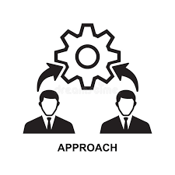
Technologies Used :
Frontend: React.js, Vite, HTML, CSS, JavaScript
Backend: Java, Spring Boot
Database: MySQL
API Communication: REST APIs
Build Tool: Apache Maven
Database Hosting: Aiven
Application Deployment: Render
Version Control: Git and GitHub

Slide 5
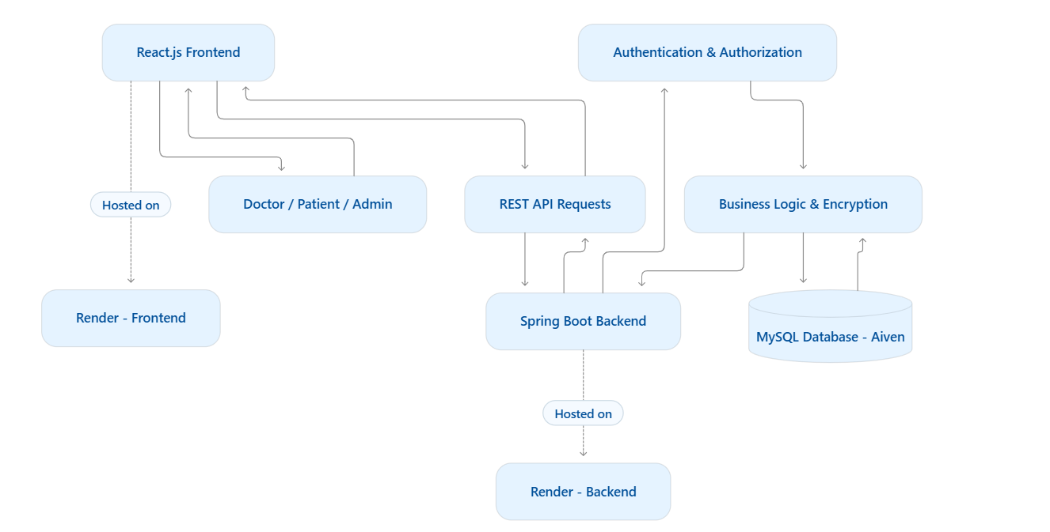
System Architecture :
Frontend: Users interact with the application through the web interface.
Backend: Spring Boot processes requests and applies application logic.
Security layer: Authentication and authorization control access; encryption protects supported sensitive data.
Database: MySQL stores and retrieves doctor, patient, and consultation information.
Deployment: Render hosts the frontend and backend, while Aiven hosts the database.

Slide 6


Expected Outcomes
Centralized storage of patient, doctor, and consultation records.
Improved protection of sensitive medical information.
Secure access based on user roles and permissions.
Faster retrieval and management of patient records.
Reduced paperwork and improved data organization.
Online access to the deployed application.
A foundation for future enhancements such as prescription management, automated backup, and recovery.

